Slide 1

How can we Assess the Performance of Downscaled Climate Information for Ecosystems and Agriculture?
Jagdish Krishnaswamy & Milind Bunyan

Slide 2
Global and regional climate change context
Weakening Monsoon
Changing intensity regime

Slide 3
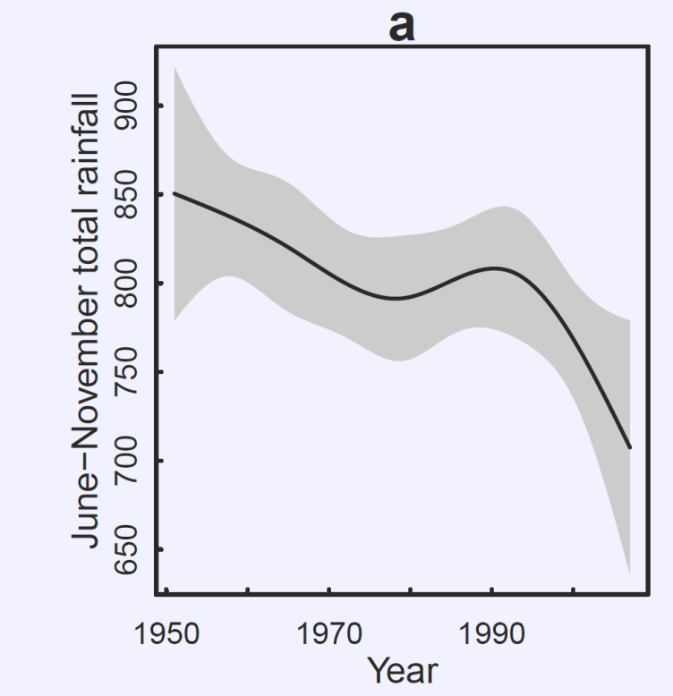
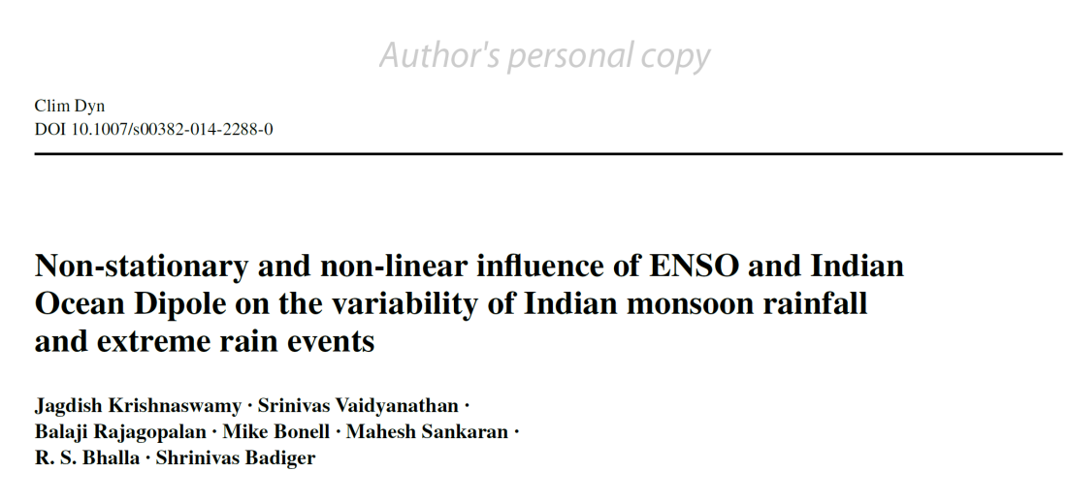
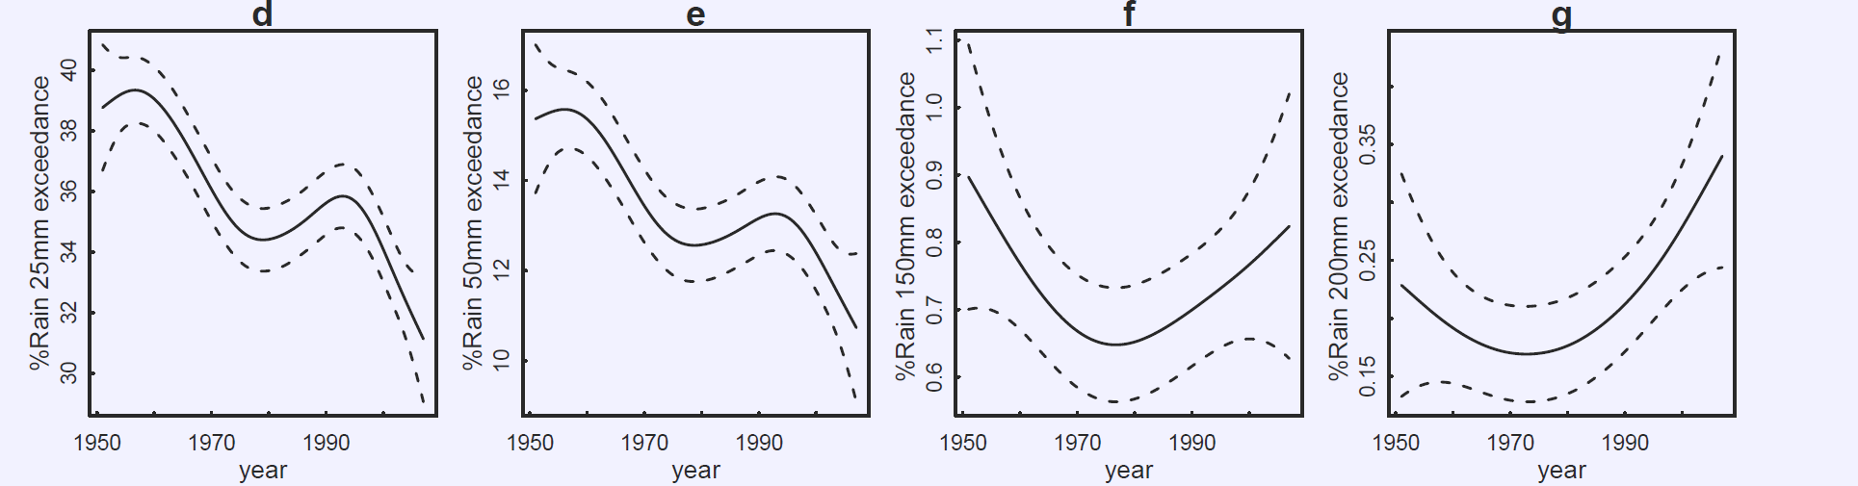
Krishnaswamy and Vaidyanathan unpublished 2017
Notes:
From a global and regional climate context, we know that there has been a weakening of the Indian monsoon and a shift in regimes with an increasing incidence of extreme rain events

Slide 4
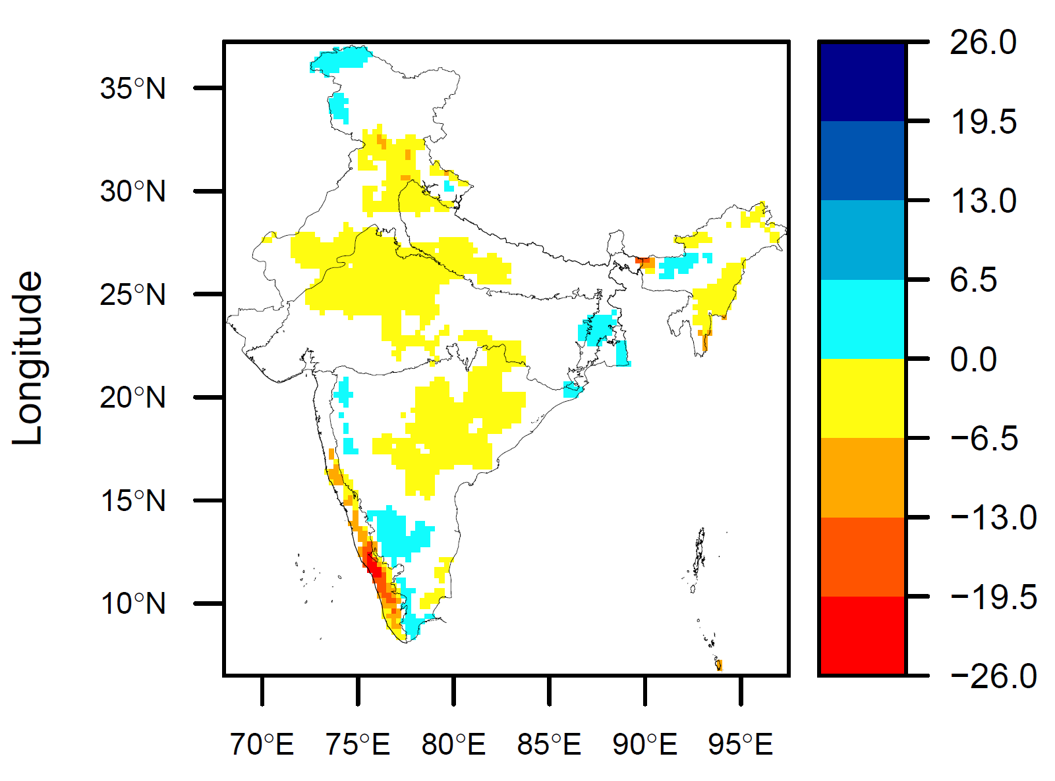
Decline in the Indian Monsoon
Krishnaswamy and Vaidyanathan, unpublished 2017

Slide 5
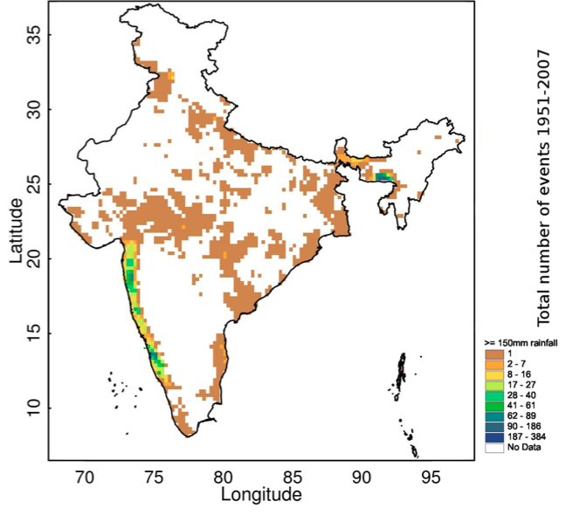

Slide 6
Assessing the utility of climate downscaled products for ecosystem response?
Do they reproduce key indices of historically observed trends (regional seasonality and intensity)?
Do downscaled historical climate products explain hydrologic and vegetation dynamics?
How can we assess their performance?
Notes:
Most people in this room will agree that we are interested in the ability of downscaled climate products to reproduce trends in seasonality or intensity for the historic period. We would also like to assess the ability of these downscaled climate products to explain hydrologic and vegetation dynamics and I want to share a few insights from observed dynamics and climate data on how we might take these forward

Slide 7
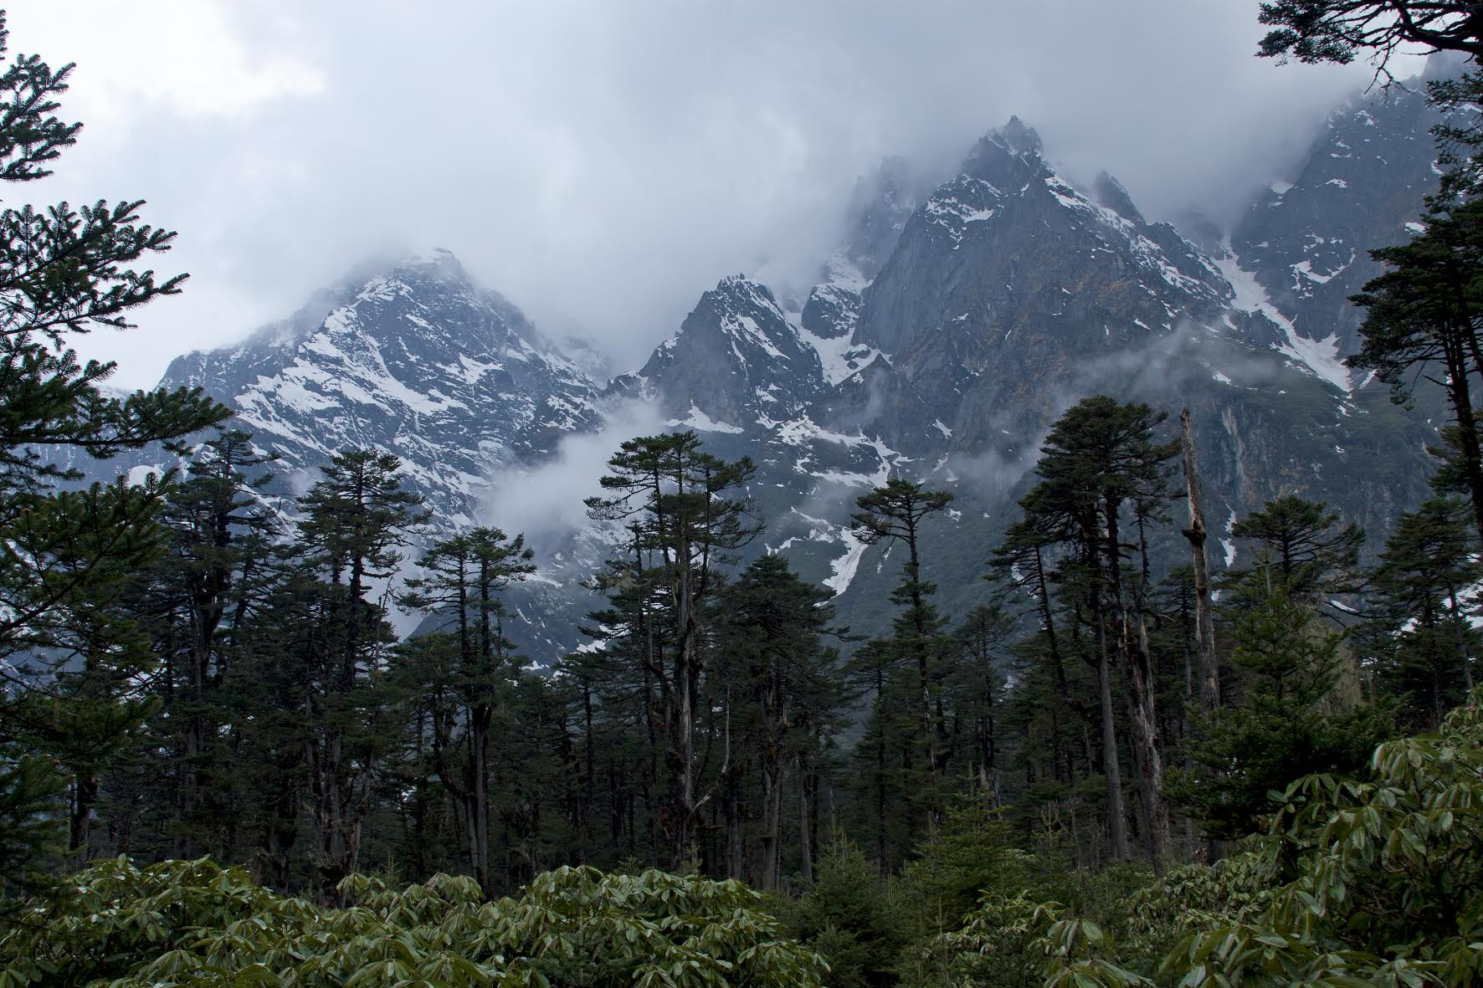
Dynamic vegetation response to climate
Sandesh Kadur

Slide 8
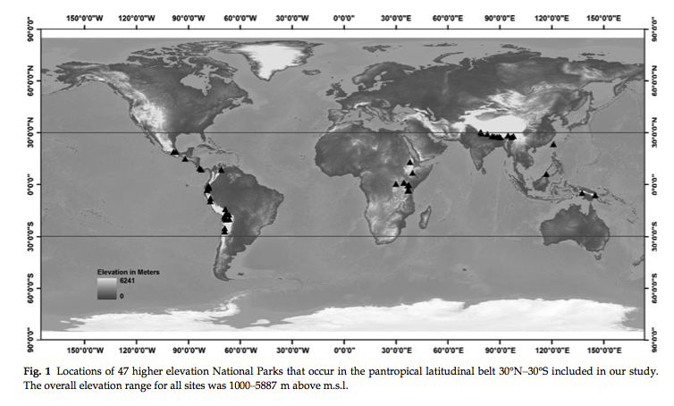
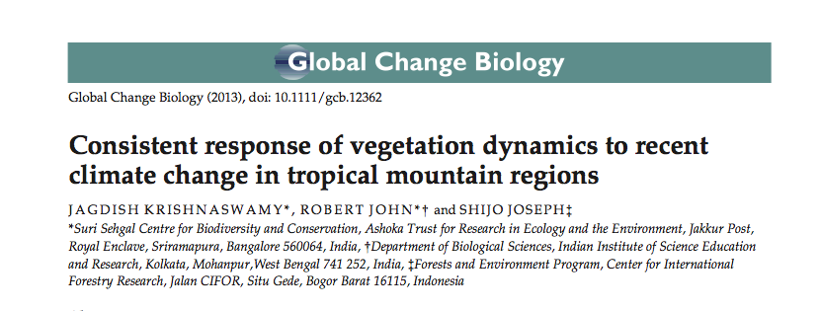

Slide 9
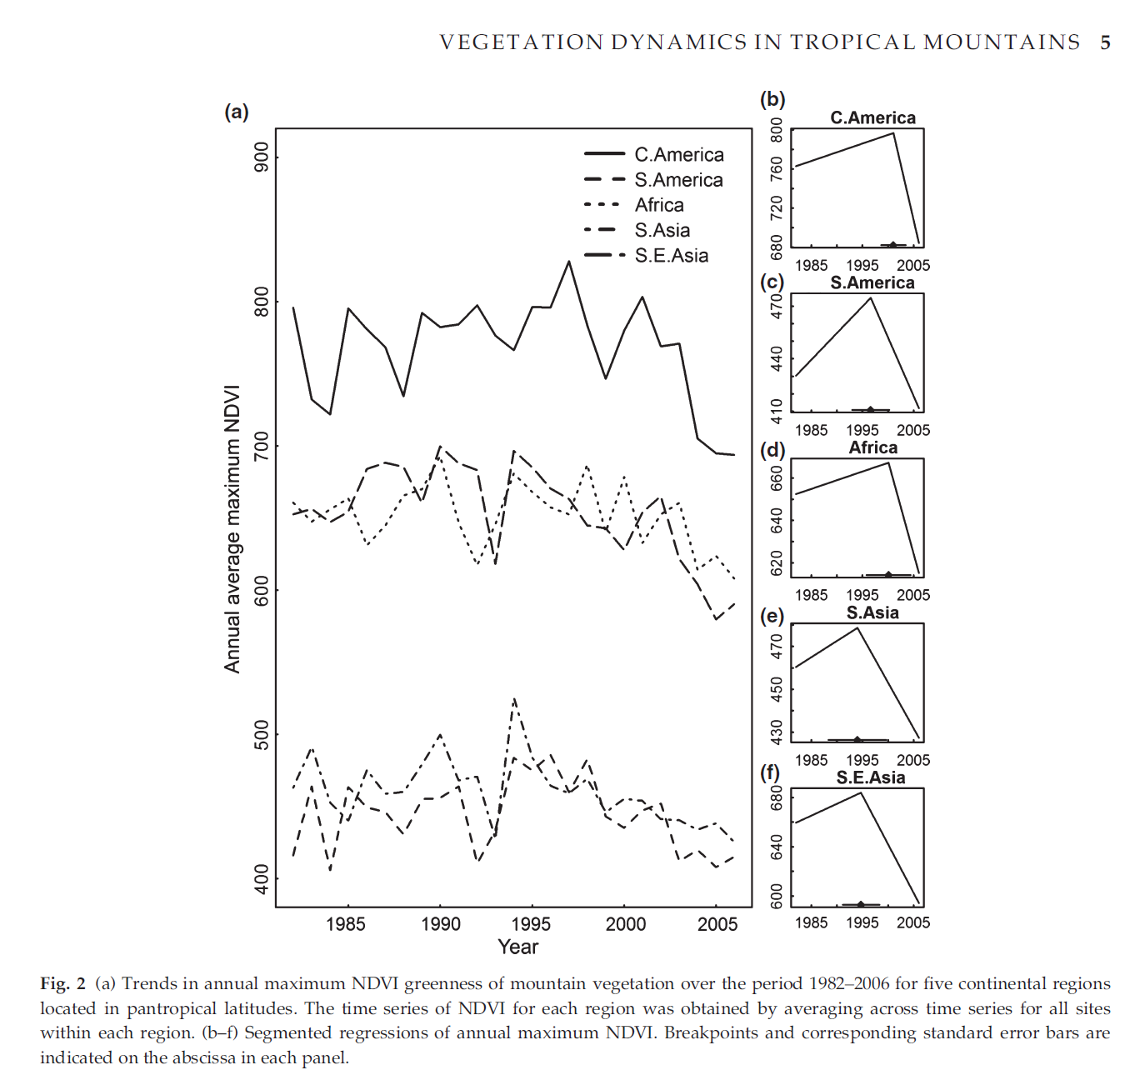
Notes:
Can change-points be reproduced

Slide 10
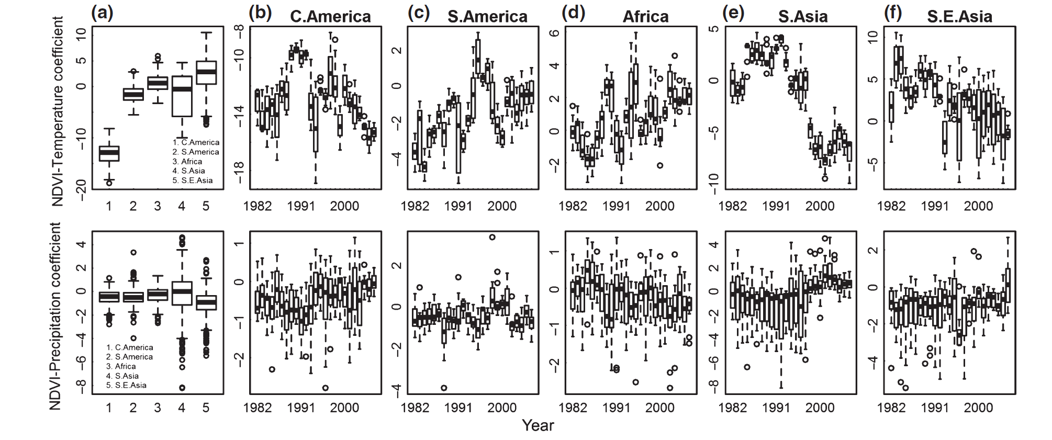
Dynamic vegetation response to climate
NDVI_{t} = Level_{t} + B1_{t}(Temperature_{t}) + B2_{t}(Precipitation_{t}) +e_{t}

Slide 11
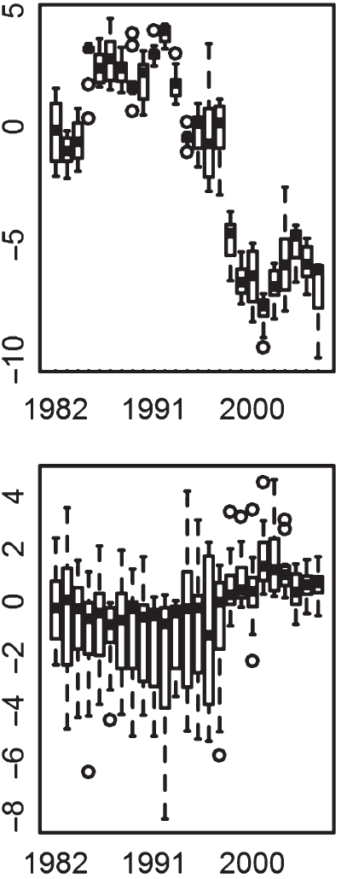
Dynamic vegetation response to climate
In the Himalayas…
Strong negative trend in NDVI-temperature coefficient
Inconsistent trend and high variation in NDVI-Precipitation coefficient
Indicative of temperature-related moisture stress in the Himalayas

Slide 12

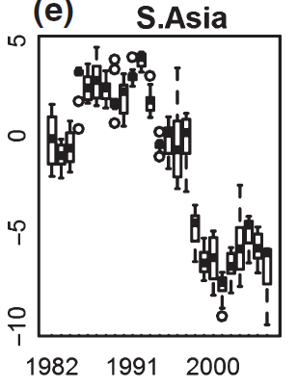
Dynamic vegetation response to climate
At high elevation, trees subjected to low water potential and undergo severe temp. and H₂O stress
A record 31°C observed in April 1999
From Sep 98-May 99, 26.5 mm rainfall was received in 3 days in January and March
Zobel et al 2001. Patterns of water potential among forest types of the central Himalaya. Current Science, 80(6), pp.774-778.
Zobel, D.B. and Singh, S.P., 1997. Himalayan forests and ecological generalizations. BioScience, 47(11), pp.735-745.
Poudyal et al 2004. Patterns of leaf conductance and water potential of five Himalayan tree species. Tree Physiology, 24(6), pp.689-699.

Slide 13
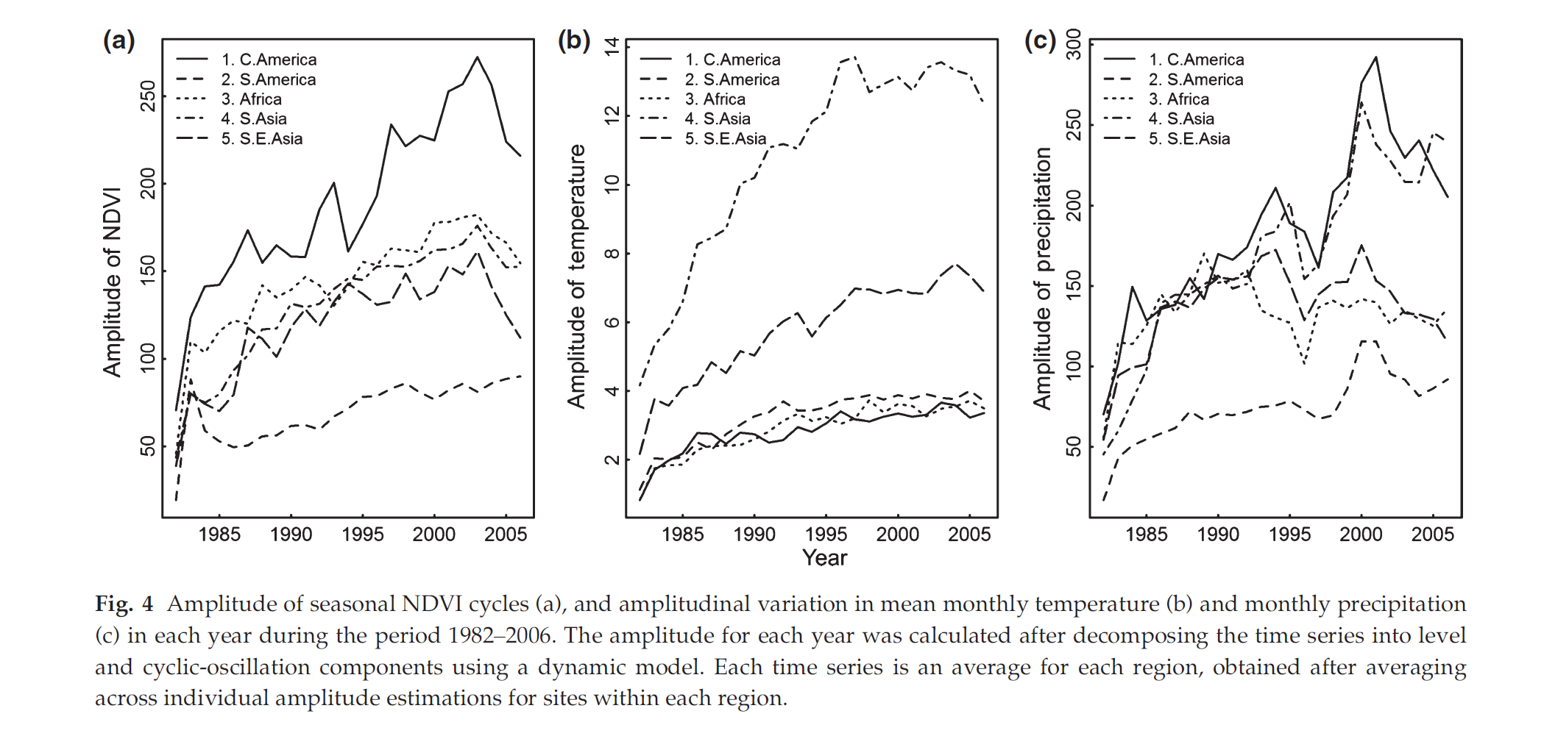
Dynamic vegetation response to climate
Can we reproduce seasonality dynamics with downscaled climate products?

Slide 14
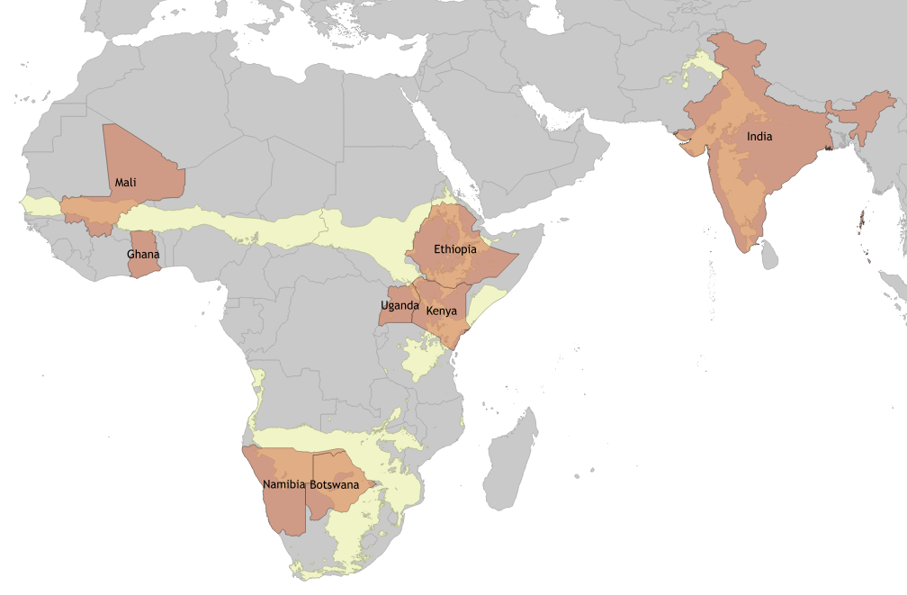

Dynamic vegetation response to climate in semi-arid regions of Africa and Asia

Slide 15
Dynamic vegetation response to climate
Greening and Browning trends
Trends in seasonal NDVI cycles
Loss of temperature positivity (indicative of temperature-related moisture stress)
Response to rainfall episodes and perturbations

Slide 16
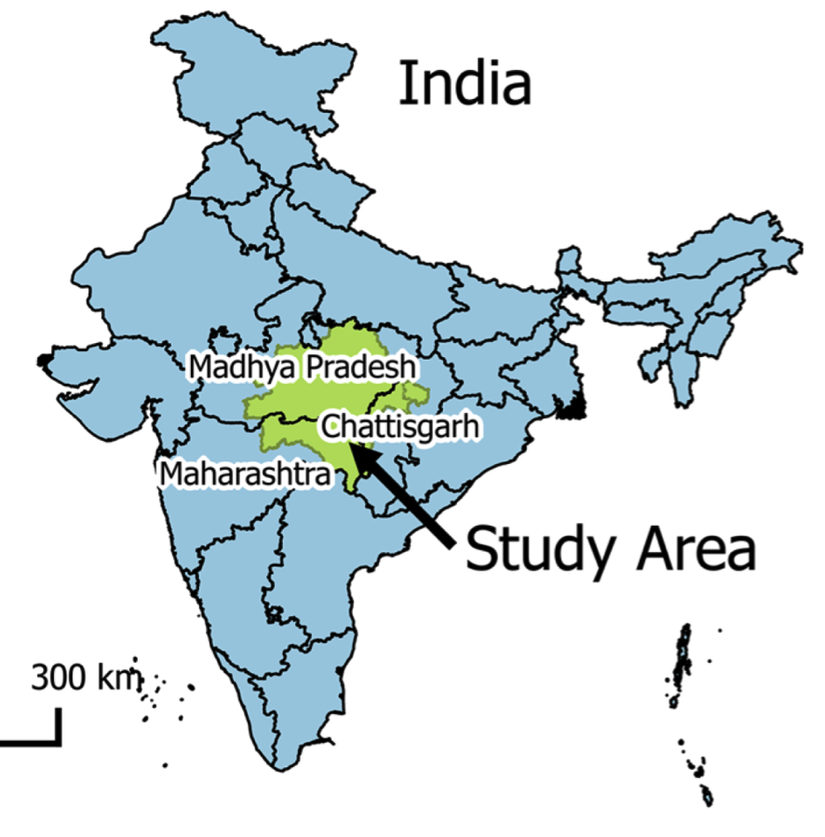
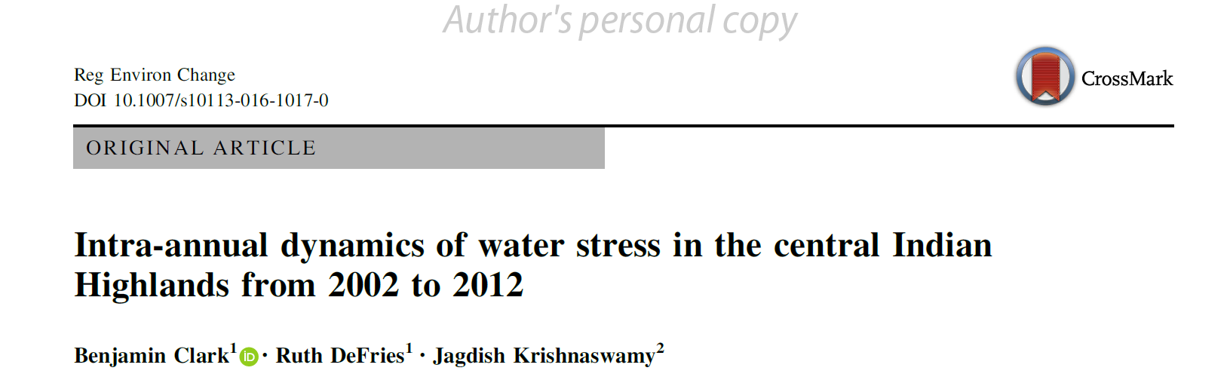
Inter-annual dynamics of water stress
Hydrologic model (modified version of Sacramento Soil Moisture Accounting Model)
Accounts for the water demand across 5 sectors; domestic, industrial, power generation, irrigation and livestock
Estimates gross water use from surface and groundwater sources and includes consumptive and non-consumptive water.

Slide 17
Inter-annual dynamics of water stress
Model represents the amount of water that must be available to meet the demand of a sub-basin. Non-consumptive use of water is returned to surface water so that it is available for downstream re-use
To avoid stress, water supply must meet the total water withdrawals.

Slide 18
Approach
Hydrologic model (modified version of Sacramento Soil Moisture Accounting Model)
Accounts for the water demand across 5 sectors; domestic, industrial, power generation, irrigation and livestock
Estimates the gross water use across sectors from surface and groundwater sources and includes consumptive and non-consumptive water.
It represents the amount of water that must be available to meet the demandof a sub-basin. Non-consumptive use of water is returned to surface water so that it is available for downstream re-use
To avoid stress, water supply must meet the total water withdrawals

Slide 19
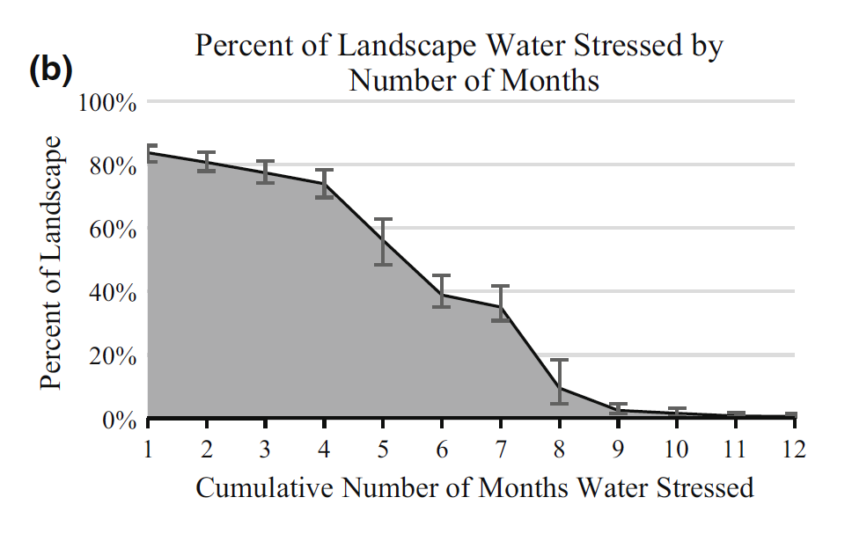
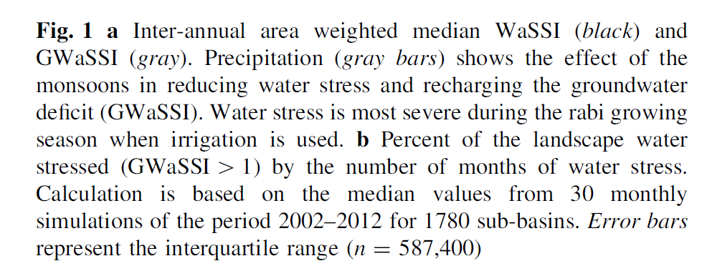
Inter-annual dynamics of water stress
A large portion of the landscape experiences water stress for at least some months of the year
Only 16% of the area remains unstressed throughout the year.
Notes:
Percent of the landscape water stressed (GWaSSI > 1) by the number of months of water stress. Calculation is based on the median values from 30 monthly simulations from 2002-2012 for 1780 sub-basins

Slide 20
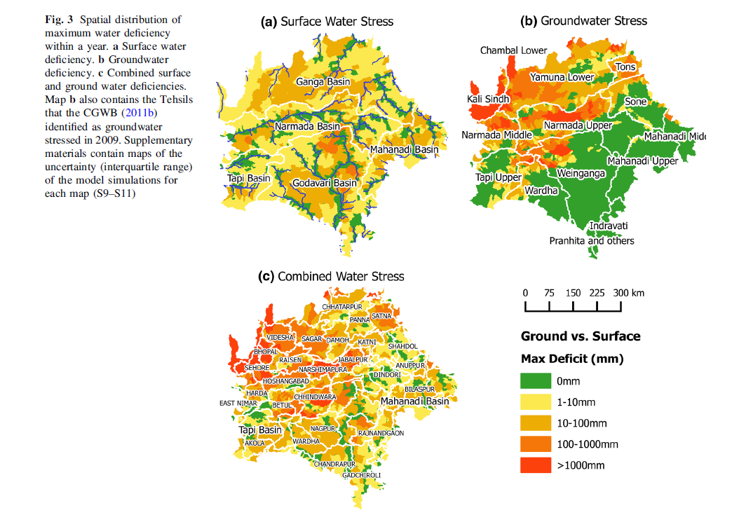
Inter-annual dynamics of water stress

Slide 21
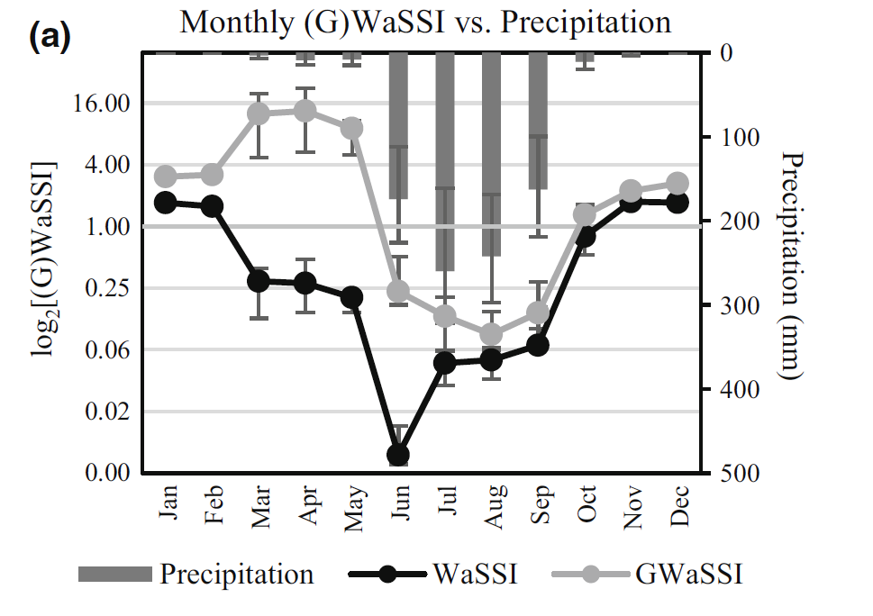
Inter-annual dynamics of water stress
Rabi season irrigation results in 74% of the landscape experiencing water stress for four or more months in a year
Can we get similar results if downscaled climate data products are used?
Notes:
Percent of the landscape water stressed (GWaSSI > 1) by the number of months of water stress. Calculation is based on the median values from 30 monthly simulations from 2002-2012 for 1780 sub-basins

Slide 22
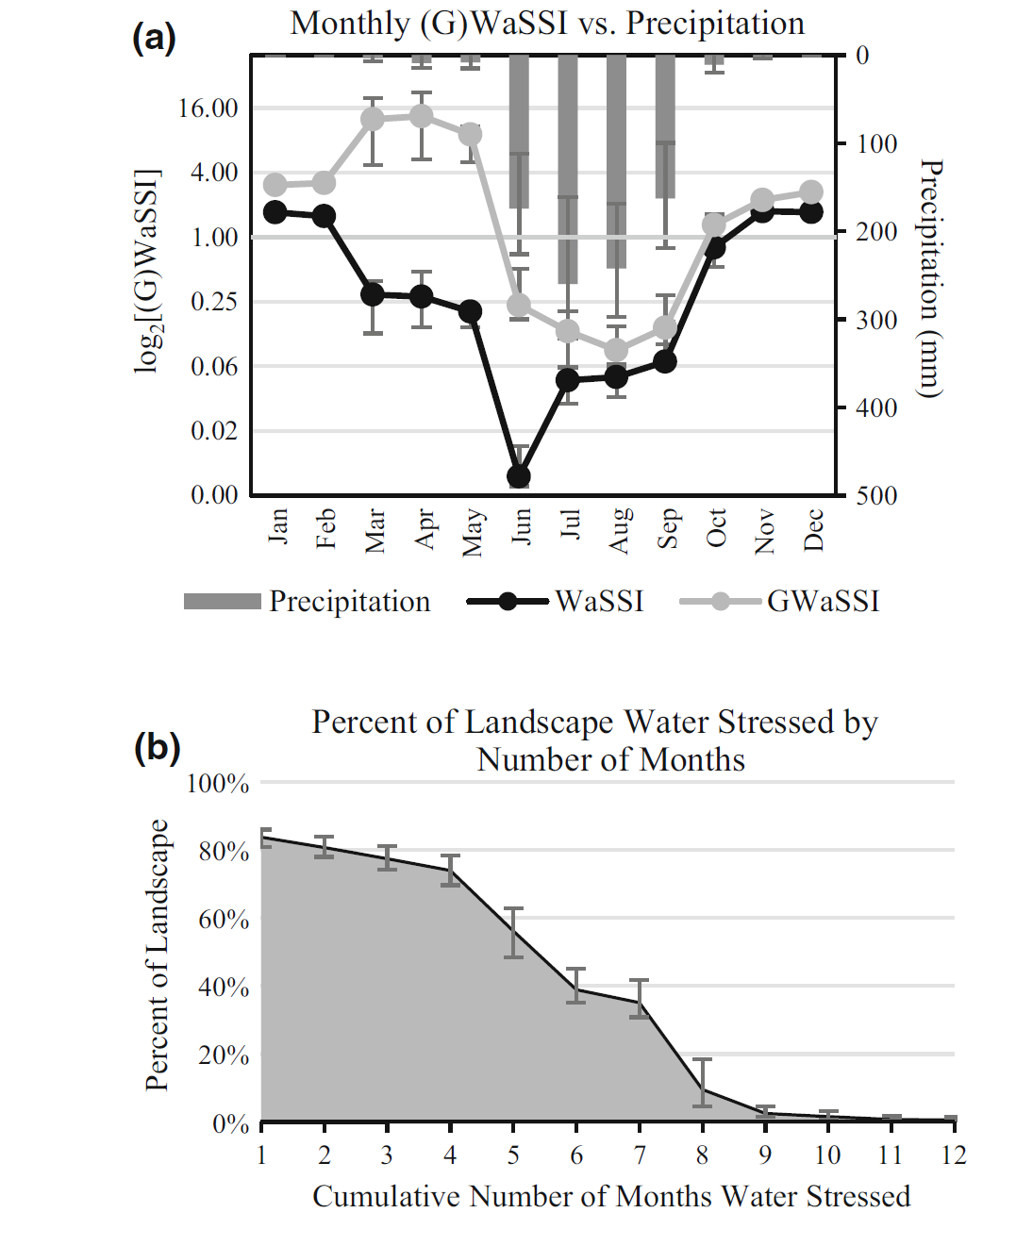

Slide 23
Key results and implications
A large portion of the landscape experiences water stress for at least some months of the year
Only 16% of the area remains unstressed throughout the year.
Rabi season irrigation results in 74% of the landscape experiencing water stress for four or more months out of the year
Can we get similar results when we feed the model with downscaled climate data products rather than observed?

Slide 24
Opportunities and Concerns
Dynamic mechanistic or data-driven hydrology and vegetation models can be used to assess performance of downscaled climate products
Can we reproduce key observed seasonal and inter-annual and longer term cycles and trends?
Climate is only one of the drivers of vegetation; need to address effects of other global and regional drivers e.g. nitrogen deposition, disease

Slide 25

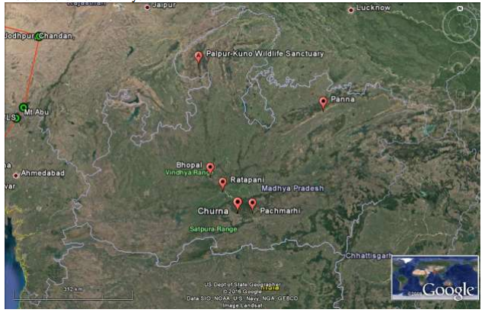
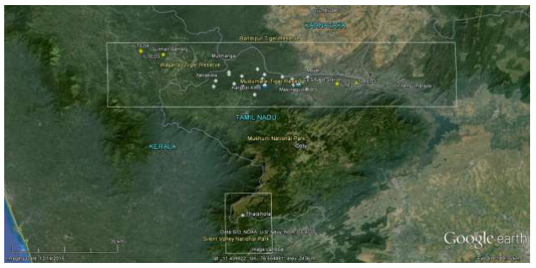
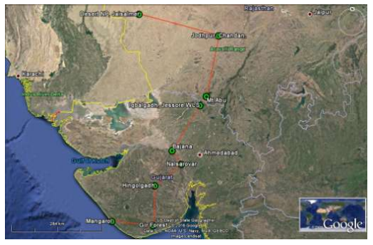
Opportunities and Concerns

